Slide 1




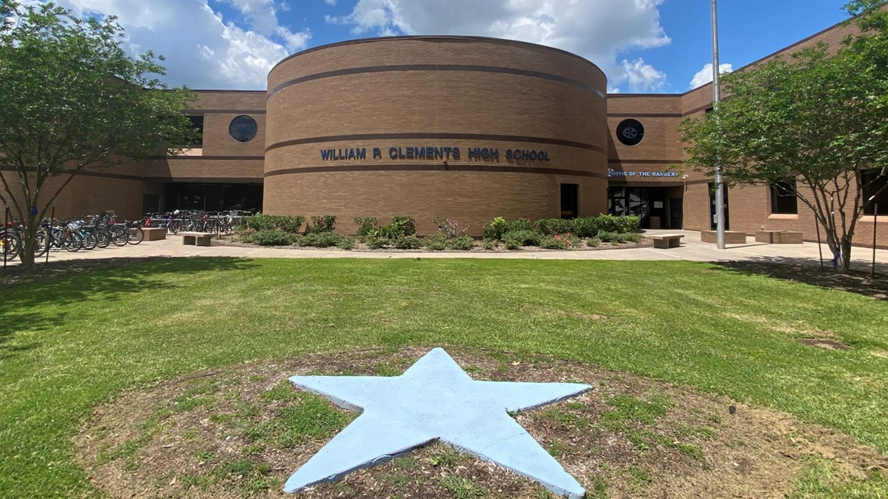



Welcome to High School
2025 - 2026
Middle School
Course Selection Presentation
CHS
Counseling Team
It’s a GREAT day to be a CLEMENTS RANGER!!!

Slide 2


Agenda
Welcome!!!
The purpose of this presentation is to assist students in planning for high school.
Students are strongly encouraged to:
  Refer to the FBISD Course Selection Guide online for more detailed and most up to date information
  CHS Counselor’s website https://www.fortbendisd.com/domain/2549
  Meet with building counselors for questions and additional guidance.
Graduation Requirements
FBISD Grading Scale
FBISD GPA Scale
Special Programs
Electives
Course Selection Input
Course Selection Timeline

Slide 3


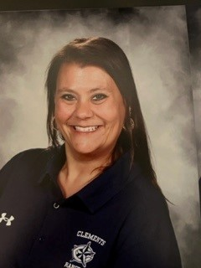

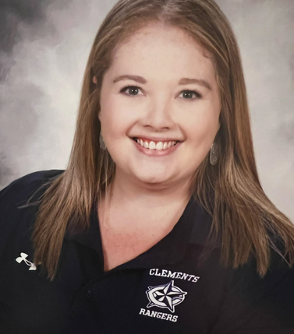
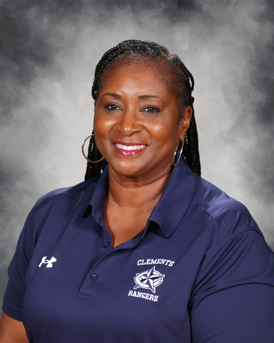
Meet your
CHS Counselors
Ms. Branch
I - Mal
Mrs. Seymour-Gipson
Mam - Pra
Let’s Learn English!
Ms. Fawcett
A - Co
Mrs. Levy
Cr - H
Ms. Drake
Pre - U
Dr. Brown
V - Z

Slide 4

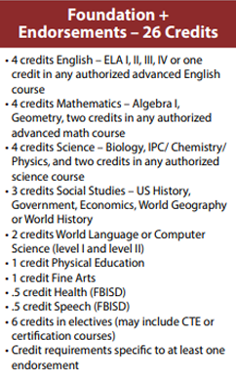
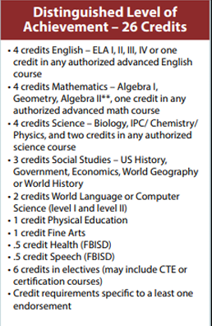
GRADUATION PLANS
Algebra 2 is required for the
Distinguished diploma

Slide 5
GRADUATION REQUIREMENTS
26 CREDITS
(according to the graduation plan)
5 End of Course Exams
English I, English II, Algebra I, Biology, and US History
Completed Endorsement

Slide 6
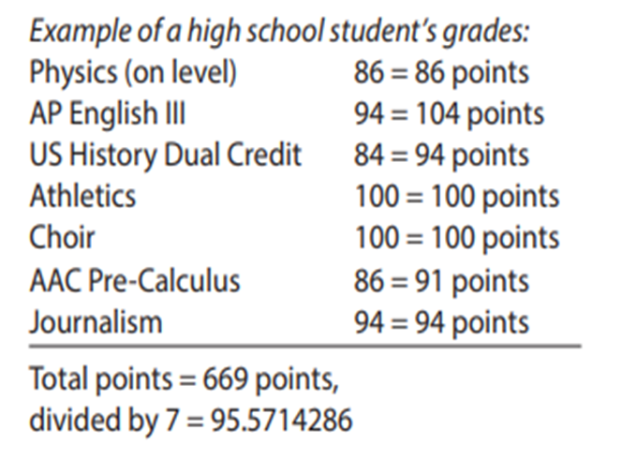
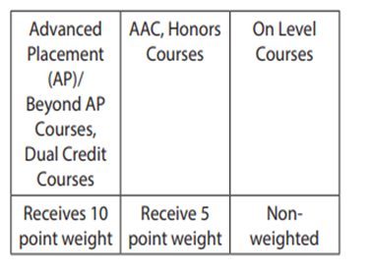
FBISD
GPA Scale
Note: GPA weight only applies to the CALCULATION of your GPA, but does not change your grade.

Slide 7

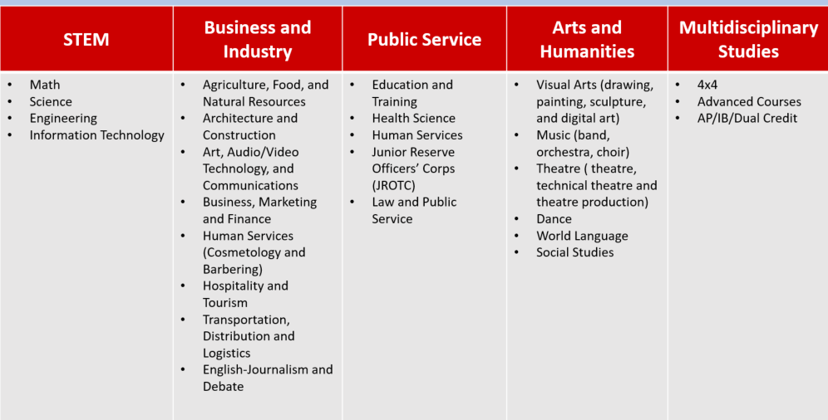
Endorsements

Slide 8
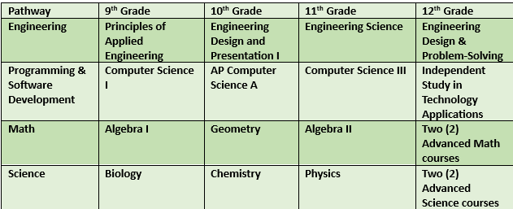
STEM

Slide 9
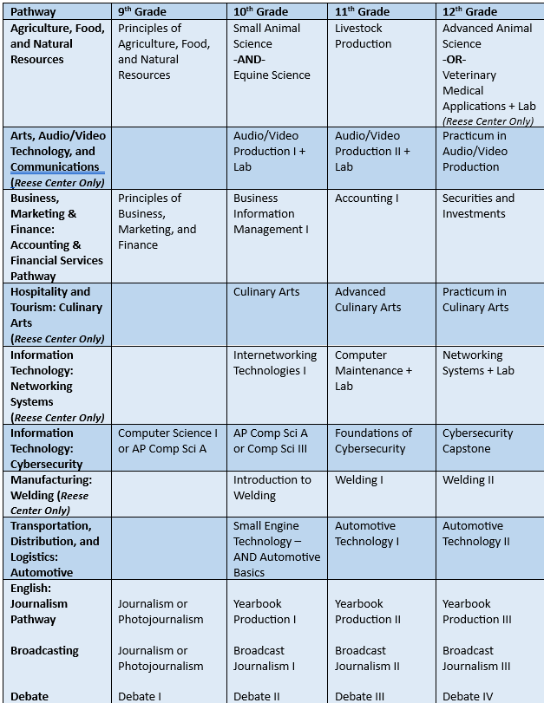
BUSINESS & INDUSTRY

Slide 10
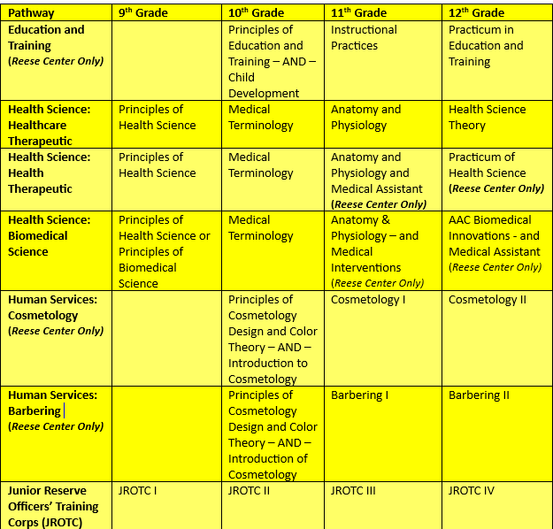
PUBLIC SERVICE

Slide 11
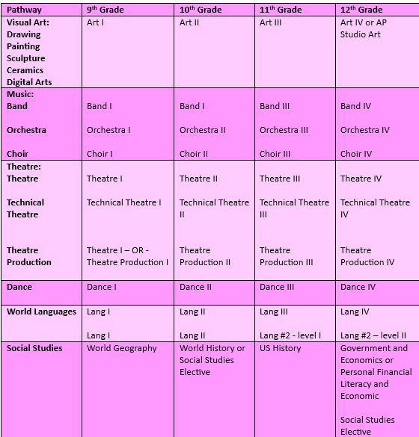
ARTS & HUMANITIES

Slide 12
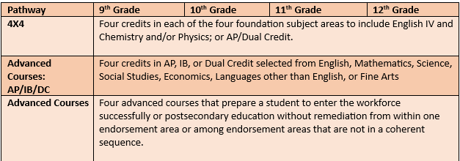
MULTIDISCIPLINARY STUDIES

Slide 13
New CTE Pathways
Starting 2025-2026 School Year
Human Services - Barbering @ Reese
Human Services - Health and Wellness
Health Science - Biomedical Science @ Reese
Information Technology - Cybersecurity

Slide 14




Special Programs
Campus Electives
Reese Center
Dual Credit
OnRamps

Slide 15

Electives offered at CHS
Science Electives
Anatomy & Physiology
Forensic Science
Astronomy
Aquatic Science
Environmental Systems
Social Studies Electives
Sociology
Psychology
Social Studies Research/AP Psychology
AP African American Studies
Special Topics: Social Studies
AP European History
CTE Courses
Computer Science
Health Science
Animal Science
Engineering
Business
Fine Arts
Art
Band
Choir
Orchestra
Dance
Theatre
Color Guard
Floral Design
AP Art History
Public Service
JROTC
Academic Programs
Debate
Journalism
Academic Decathlon

Slide 16



James Reese Career & Technical Center

Slide 17




OnRamps
Dual Enrollment in CHS and UT Austin
Get college credit if YOU CHOOSE. You can deny the college credit, but not the high school credit
No AP exam required for college credit
No cost to you!!! (IT’S FREE!!!!!)

Slide 18
OnRamps course offerings
2025-2026
Biology
*Chemistry I
Chemistry II
Physics I
Physics II
*College Algebra
Precalculus
Statistics
*Economics
*US History
Course offerings for
Dual Credit and OnRamps will be dependent on requests and teacher availability.
*Current campus offerings

Slide 19



Dual Credit
Get college credit on CHS campus via Houston Community College (HCC) professor
No AP exam required for college credit.
Requirements:
  Must be in grades 10 - 12
  Meet all coursework pre-reqs
  Complete application process required by HCC
Currently CHS offers English 4 DC (English 1301/1302)

Slide 20
Choose your courses carefully!
Before committing to an advanced class, take a moment to reflect on whether you have the time and resources to dedicate to the course. We have had instances in the past where students enrolled in advanced courses – AAC and AP, only to request a level down after struggling with assignments and realizing they could not devote enough time to studying. For example, this year we had over 60 students enroll in Biology AAC and 42 in English I AAC, who later requested to move to a lower level due to academic challenges and time constraints.
We want to ensure that all students are set up for success, so please carefully assess your schedule and workload before finalizing your choices.
Counselors will only be doing schedule CORRECTIONS, not schedule changes, after the course verification period ends. Choose your courses carefully! :)

Slide 21
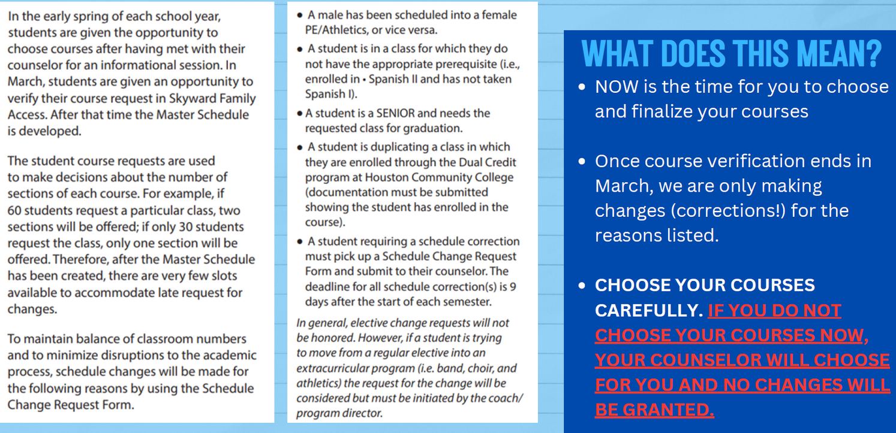
Procedure for Schedule *CORRECTIONS*

Slide 22
GUIDELINES FOR EXITING AN AAC/AP COURSE
  You must remain in the AAC/AP course for the first three (3) weeks of the school year.
  Level-downs will be considered in the following circumstances:
    you have a 75 or below in the course
    You have met with your teacher to create a plan for success
    you fill out the level-down form by the deadline
  Even if you meet the criteria, level-downs can only be considered if there is space in an on-level class
  Prior to requesting a change in level, the student must have met with the teacher and put in place a plan for success. If the teacher and student feel the plan has been followed, and the student has completed all assignments, a request for a conference to discuss removal may be made.
  Success in an AAC/AP course is defined as having a grade of 75 or higher. Students may not request a lecel change with the intent to improve their GPA.
  If a student levels down to a non-weightes class, the grade from the AAC/AP course will transfer with them to the new class.
  CHOOSE YOUR COURSES CAREFULLY!!!!

Slide 23
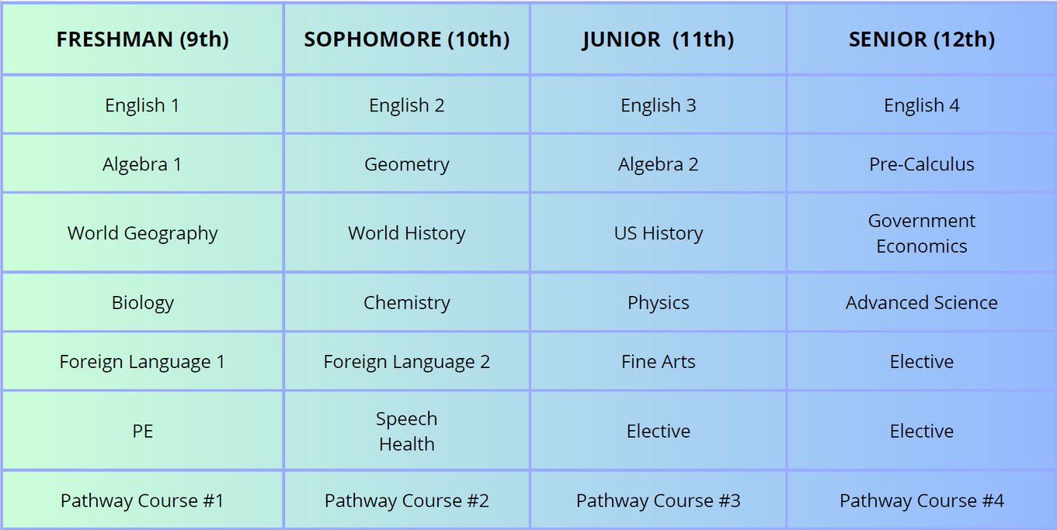
Sample 4-Year Plan

Slide 24
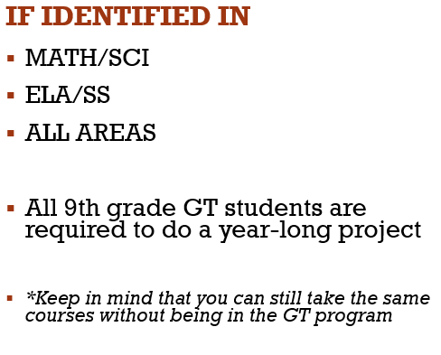

FBISD Gifted & Talented Program

Slide 25
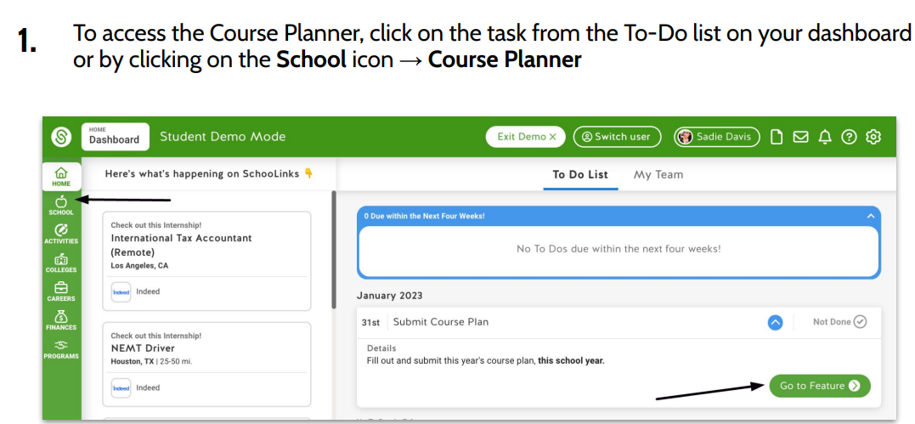
How to input your course requests:
Step 1

Slide 26
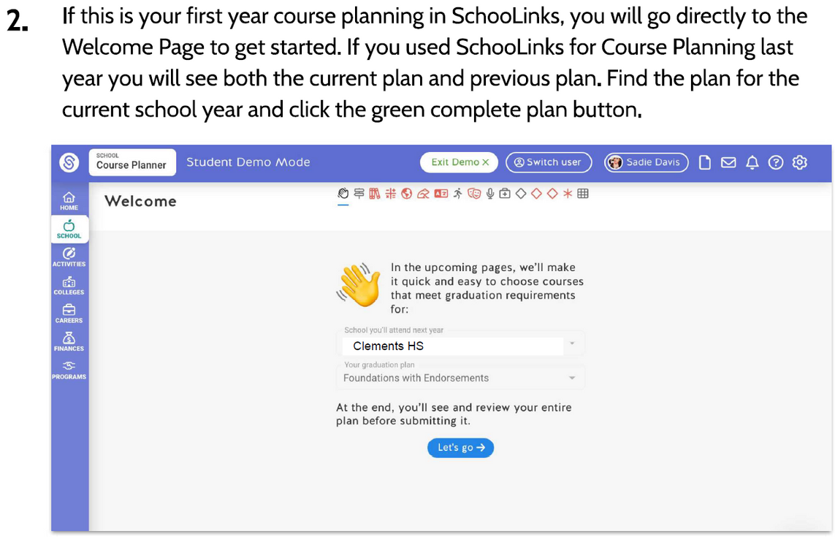
Step 2

Slide 27
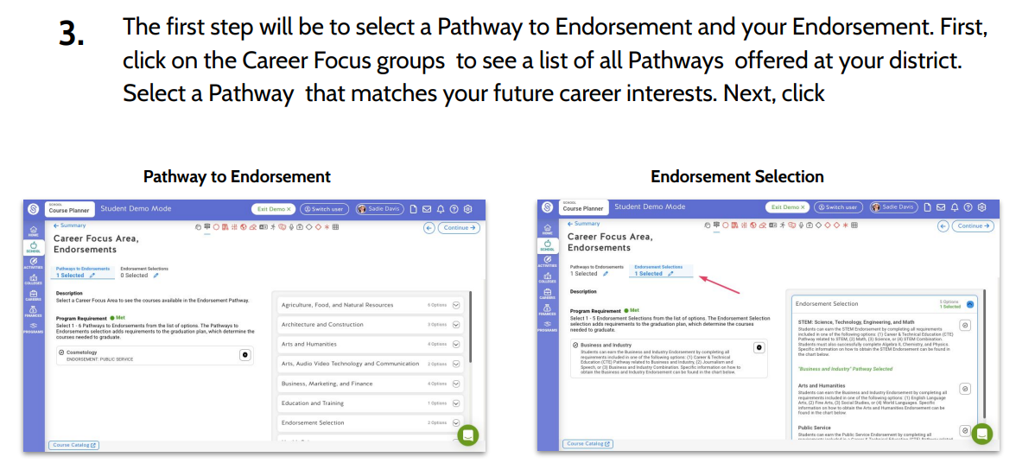
Step 3

Slide 28
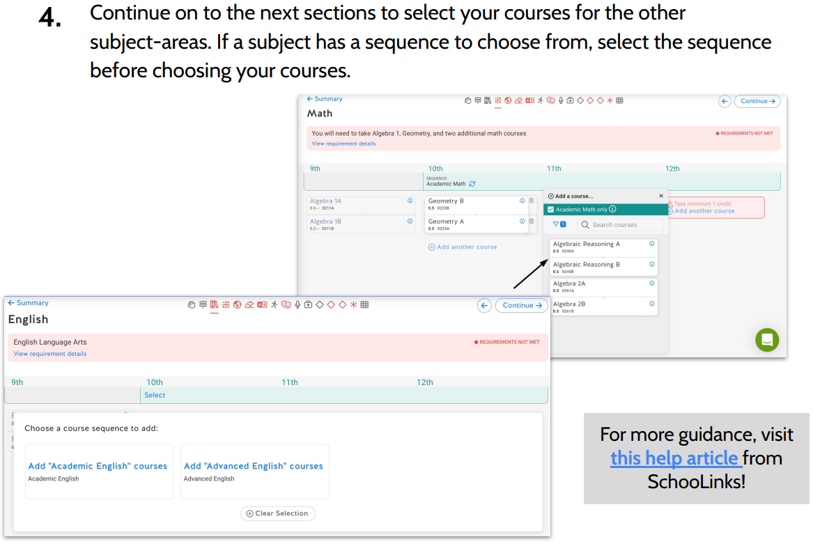
Step 4

Slide 29
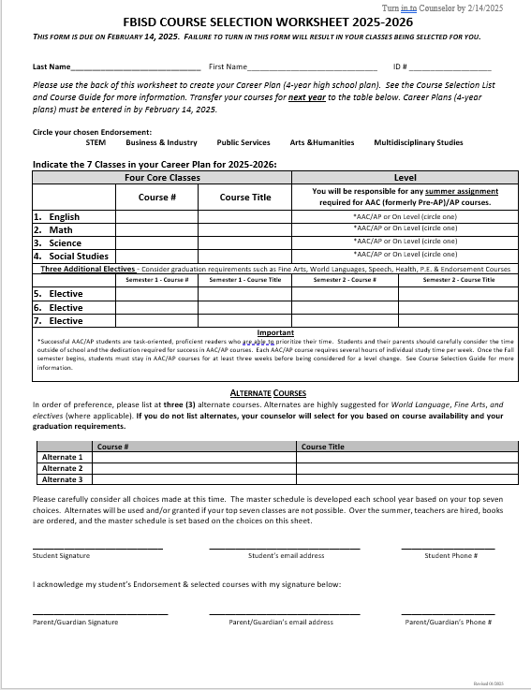
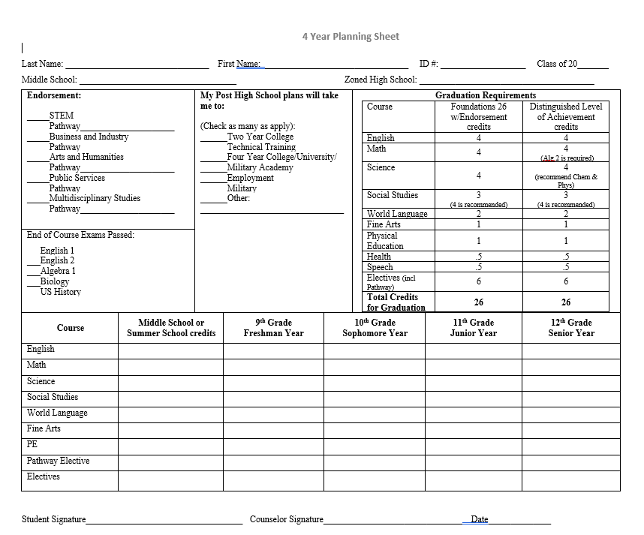
Confirm your choices
8th Grade Course Selections Forms

Slide 30
Confirm your choices using the Jot Form
Special Course Form
Use if you are unable to select a course that you have the prerequisites for:
https://form.jotform.com/243464884761165
Parent Verification Form
Use if you want to request any course changes during the Parent Verification Window:
https://form.jotform.com/250066338838160

Slide 31

COURSE SELECTION TIMELINE
January 27 - February 14
SchooLinks opens for course requests
February 17 - 28
Student course request cleanup
by CHS Counselors
(no action needed from students)
March 3 - 7
Skyward Parent Course Verification
March 24, 2025
Begin building the Master Schedule

Slide 32
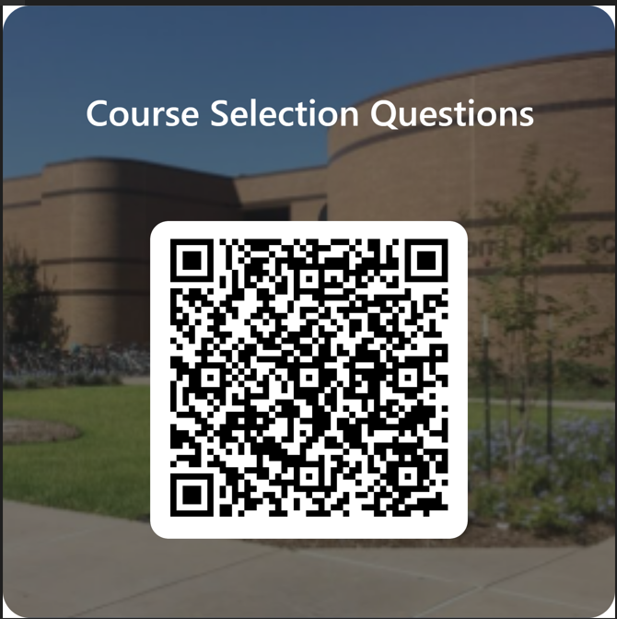
QUESTIONS

Slide 33


Thank You
It’s a GREAT day to be a CLEMENTS RANGER!!!

